Slide 1
How to embed media files from assignments that you have submitted onto Canvas.

Slide 2
Step 1. Log in to the K-State website and go to Canvas.

Slide 3
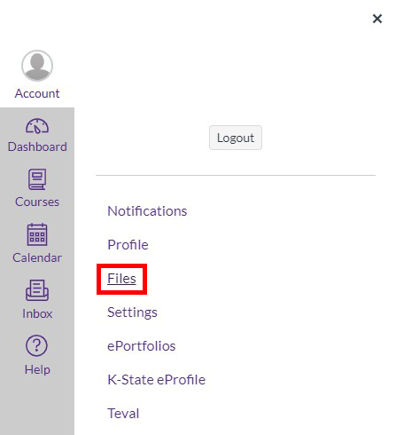
Step 2. Click on Account and then click on Files.

Slide 4
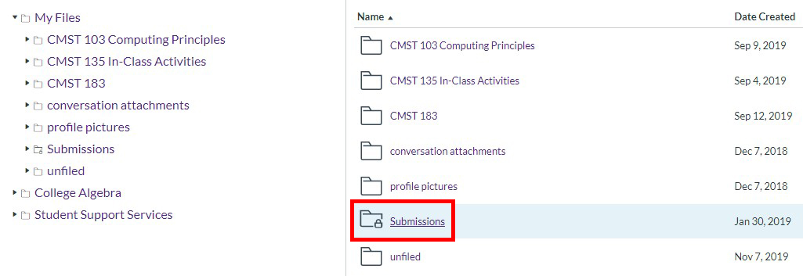
Step 3. Click on the Submissions folder.

Slide 5
Step 4. Find the folder for the class that you submitted the desired file to and click on it.

Slide 6
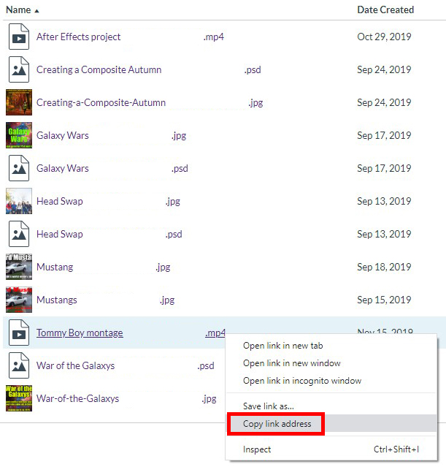
Step 5. All the files that you submitted as parts of assignments on Canvas for that specific class will be on the screen now. Right click on the file that you want to embed and select Copy Link Address.

Slide 7
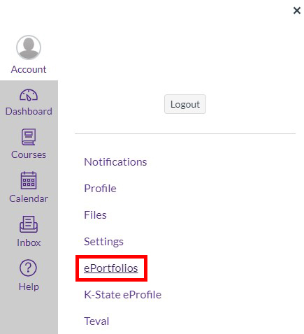
Step 6. Click on Account and then click on ePortfolios.

Slide 8
Step 7. Find the page where you want to embed the file.

Slide 9
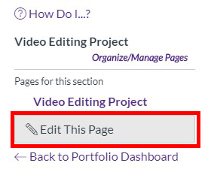
Step 8. Once you’re on the desired page, click on Edit This Page towards the top right of the webpage.

Slide 10
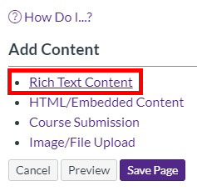
Step 9. Below Add Content, click on Rich Text Content. A Rich Text Content box will appear on the webpage.

Slide 11
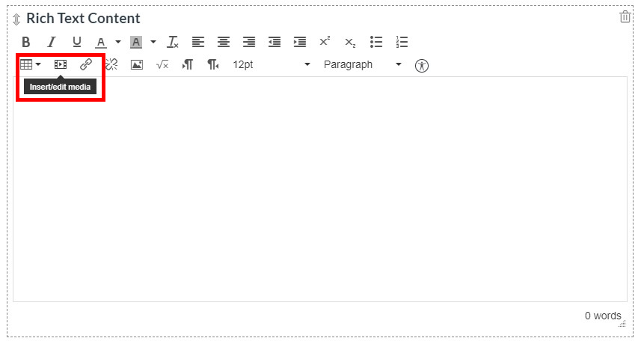
Step 10. Inside the Rich Text Content box you will find a button that when you hover your mouse over it will say Insert/Edit Media, click on it. An Insert/Edit Media window will appear.

Slide 12
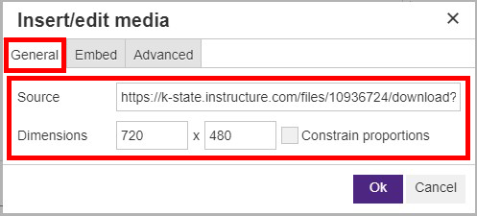
Step 11. While on the General Tab, paste the Link Address that you copied before into the Source line. It will ask you to specify the dimensions of the file. Once you are done, click on OK.

Slide 13
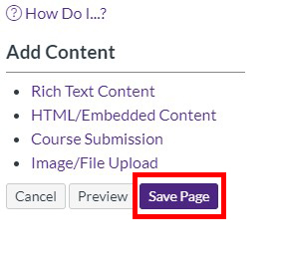
Step 12. Click on Save Page.

